Slide 1
Power Analysis
Cole Brookson & Alex Davis
25 October 2021

Slide 2
What is “Power”?

Slide 3
What is “Power”?
Power – the probability of detecting an effect, given the effect is truly there

Slide 4
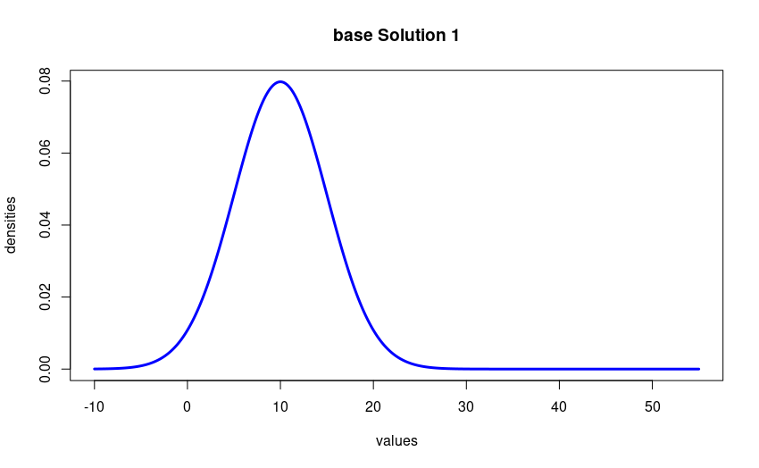
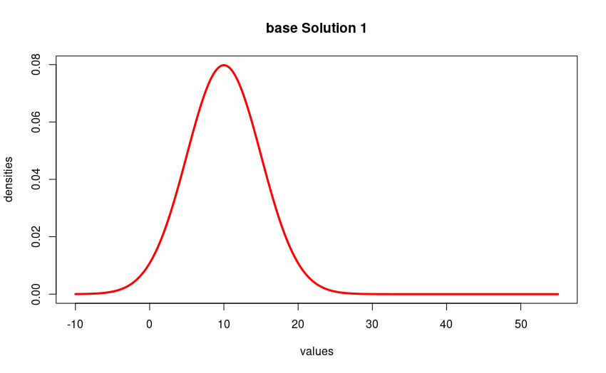
What is “Power”?
Fish 1
Fish 2
0 100
Body Size
Notes:
Let’s say we have two fish species and we think that they’re generally of different sizes. And let’s say these are actually the true distributions of their sizes, but we don’t know this yet. To ask this question, how would we state our null vs. alternate hypothesis?

Slide 5
What is “Power”?
Fish 1
Fish 2
0 100
Body Size
p<0.005
Notes:
So like good biologists, we go out and we sample some natural system in a boat or something, and we capture four fish of each species. We look at their sizes, and decide that the mean values are far enough away from one another using some nice statistical test that the value of p is less than 0.005 and the two species are in fact significantly different in size.

Slide 6
What is “Power”?
Fish 1
Fish 2
0 100
Body Size
p<0.005
Notes:
So like good biologists, we go out and we sample some natural system in a boat or something, and we capture four fish of each species. We look at their sizes, and decide that the mean values are far enough away from one another using some nice statistical test that the value of p is less than 0.005 and the two species are in fact significantly different in size.

Slide 7
What is “Power”?
Fish 1
Fish 2
0 100
Body Size
p<0.005
Notes:
So like good biologists, we go out and we sample some natural system in a boat or something, and we capture four fish of each species. We look at their sizes, and decide that the mean values are far enough away from one another using some nice statistical test that the value of p is less than 0.005 and the two species are in fact significantly different in size.

Slide 8
What is “Power”?
Fish 1
Fish 2
0 100
Body Size
p<0.005
Notes:
So like good biologists, we go out and we sample some natural system in a boat or something, and we capture four fish of each species. We look at their sizes, and decide that the mean values are far enough away from one another using some nice statistical test that the value of p is less than 0.005 and the two species are in fact significantly different in size.

Slide 9
What is “Power”?
Fish 1
Fish 2
0 100
Body Size
p<0.005
Notes:
So like good biologists, we go out and we sample some natural system in a boat or something, and we capture four fish of each species. We look at their sizes, and decide that the mean values are far enough away from one another using some nice statistical test that the value of p is less than 0.005 and the two species are in fact significantly different in size.

Slide 10
What is “Power”?
Fish 1
Fish 2
0 100
Body Size
p>0.05 - INSIGNIFICANT
Notes:
However eventually if we do this enough times, we’ll get some sample that looks like this. And in this example, we’ll INCORRECTLY reject the null hypothesis that we originally stated!

Slide 11
What is “Power”?
Power in this case is the probability of correctly rejecting the null hypothesis
Fish 1
Fish 2
0 100
Body Size
p>0.05 - INSIGNIFICANT
Notes:
So this is power in our case. And we can see that in this example where our two distributions are VERY different, we have a pretty high probability of getting a small p-value and correctly rejecting the null hypothesis.

Slide 12
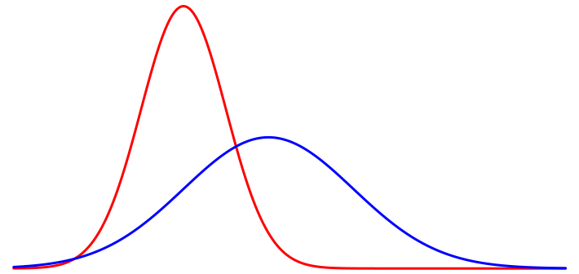
What is “Power”?
0 100
Body Size
p>0.05
Notes:
So this is power in our case. And we can see that in this example where our two distributions are VERY different, we have a pretty high probability of getting a small p-value and correctly rejecting the null hypothesis.

Slide 13
What is “Power”?
When there is a lot of overlap between our distributions AND we have a small sample size, we have low power
0 100
Body Size
p<0.05 – Significant!
Notes:
So this is power in our case. And we can see that in this example where our two distributions are VERY different, we have a pretty high probability of getting a small p-value and correctly rejecting the null hypothesis.
When doing basic biological research, you often don't know how big a difference you're looking for, and the temptation may be to just use the biggest sample size you can afford, or use a similar sample size to other research in your field. You should still do a power analysis before you do the experiment, just to get an idea of what kind of effects you could detect

Slide 14
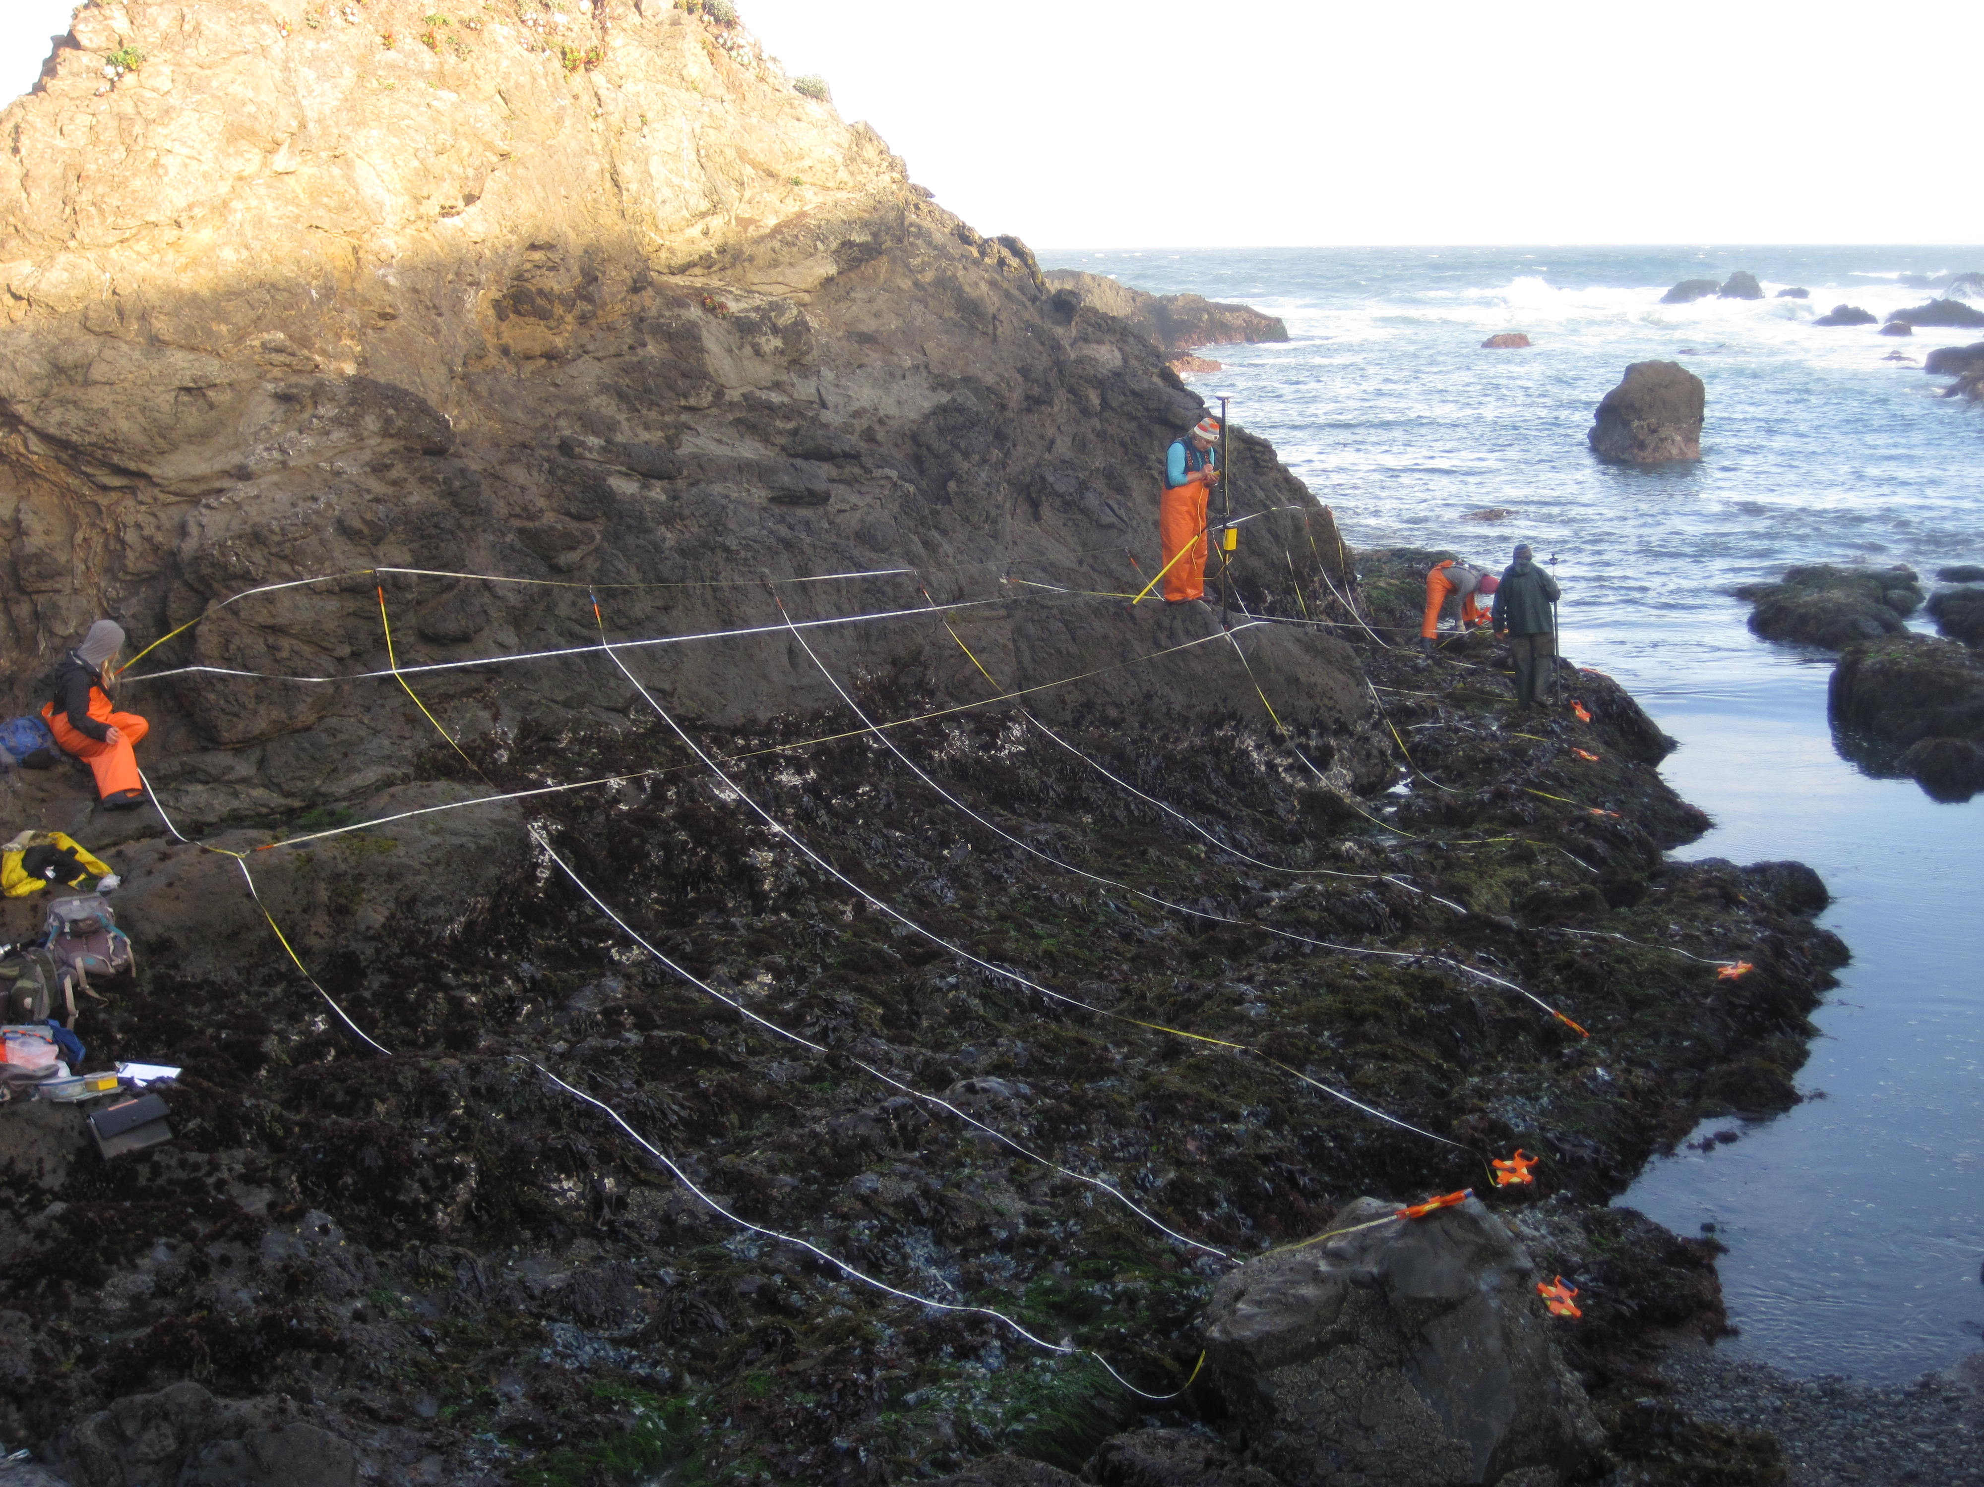
Power Analysis in Biology
Notes:
Collecting data is sooooooo expensive!!!!! Before you go through all the effort of designing a study, convincing a supervisor to give you money, paying field assistants etc, it’s an incredibly good idea to figure out if the type of data collection you have the resources to DO, will actually answer your question. I have seen SOOOOO many field biologists trot out into the field, sometimes the literal fields of alberta, and come back in the fall with all these data and THEN decide what analyses they want to do with their data. And then I watch them give a talk about it and it’s very clear that what they’re saying is full of shit because the data they collected can’t actually answer the question they’re posing! And then they come crawling to the desktop ecologists asking for some fix with a fancy model, when in reality, they could have saved themselves a ton of pain and headache if they’d just done a power analysis.

Slide 15
Power Analysis in Biology
A warning from a desktop ecologist:
DO A POWER ANALYSIS!!!!
Notes:
Collecting data is sooooooo expensive!!!!! Before you go through all the effort of designing a study, convincing a supervisor to give you money, paying field assistants etc, it’s an incredibly good idea to figure out if the type of data collection you have the resources to DO, will actually answer your question. I have seen SOOOOO many field biologists trot out into the field, sometimes the literal fields of alberta, and come back in the fall with all these data and THEN decide what analyses they want to do with their data. And then I watch them give a talk about it and it’s very clear that what they’re saying is full of shit because the data they collected can’t actually answer the question they’re posing! And then they come crawling to the desktop ecologists asking for some fix with a fancy model, when in reality, they could have saved themselves a ton of pain and headache if they’d just done a power analysis.

Slide 16
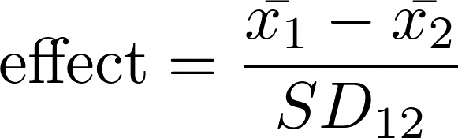
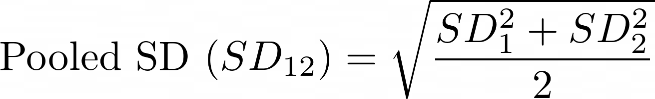
Nitty gritty of power
Effect Size – minimum deviation from the null hypothesis that you hope to detect
Notes:
Effect size is specific to the question you’re asking and how much you need to see an effect. In our fish size example, it might be that we want to detect when our fish our 10% bigger than the other species. That would make our effect size 0.1. For an example of how an abiotic stressor affects something, if you do a test and raise the temperature on some mussels by 5 degrees, maybe you want to see if they change their growth rate by at least 25% then the effect size is 0.25.

Slide 17
An Aside on Significance...
Statistically significant =/= Biologically significant
Statistically significant =/= Biologically significant
Notes:
People do think about this, but usually not BEFORE they collect data.

Slide 18
An Aside on Significance...
Statistically significant =/= Biologically significant
Statistically significant =/= Biologically significant
Statistically significant...
...statistical analysis has revealed an effect unlikely to have occurred by chance alone. The level of significance refers to the degree to which the result could be explained by chance.
Biologically significant...
...a statistically significant effect that has a noteworthy impact on the process of interest. If an observed effect is small but quite precise, the effect can be statistically significant even if it isn’t biologically significant.

Slide 19
Nitty gritty of power
How much power? – depends on the field and how much weight you’re putting on your findings. Also differs by test type.
Notes:
How much power you need often will be different depending on how important your findings might be. If you’re putting a new drug on the market often power needs to be high. In ecology, power tends to be low by nature of how we collect data.

Slide 20
Nitty gritty of power
Type I/II Errors:

Slide 21
Nitty gritty of power
Type I/II Errors:
False Positive – null hypothesis rejected when there is no effect
False Negative – null hypothesis accepted when there is an effect

Slide 22
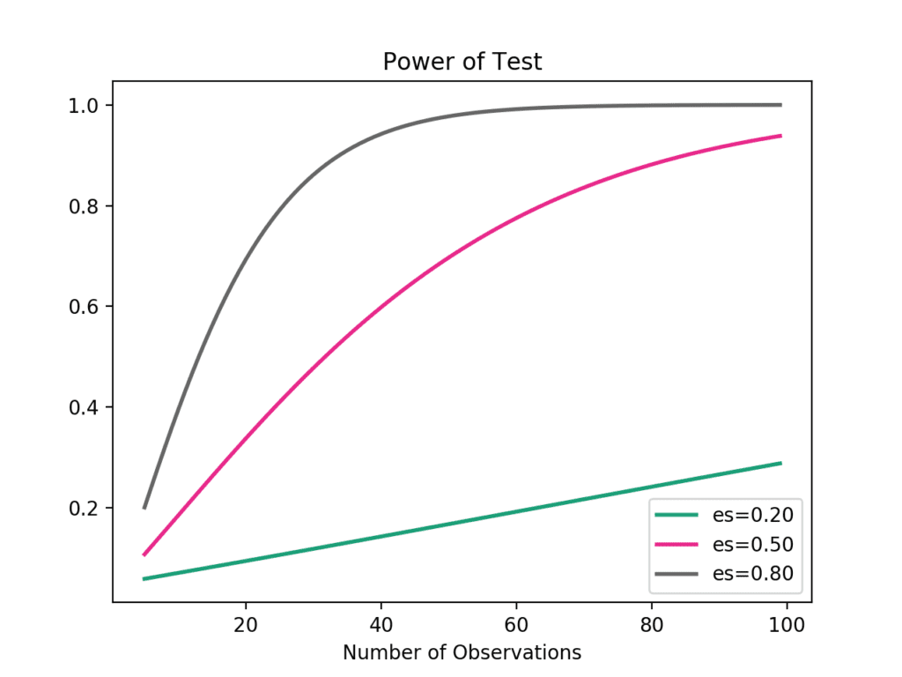
Nitty gritty of power
Effect, Power, Alpha, Sample Size
- if three of these are fixed, we can find the fourth!
Cohen (1988)
Notes:
We’ll go through an example and it’ll make more sense. Remember that alpha is our statistical significance – usually 0.05.

Slide 23
Why do a Power Analysis?
To figure out how much data you need, or more often, given the amount of data you think you’ll be able to get, how much power you’ll actually have – thus justifying the study

Slide 24
Why do a Power Analysis?
To figure out how much data you need, or more often, given the amount of data you think you’ll be able to get, how much power you’ll actually have – thus justifying the study
They’re often required for grant proposals (and more ecological research should require power analyses)

Slide 25
Why do a Power Analysis?
To figure out how much data you need, or more often, given the amount of data you think you’ll be able to get, how much power you’ll actually have – thus justifying the study
They’re often required for grant proposals (and more ecological research should require power analyses)
They’re a part of doing good research – good way of making sure you’ve thought through every aspect of the study AND the statistical analysis BEFORE you start collecting data

Slide 26
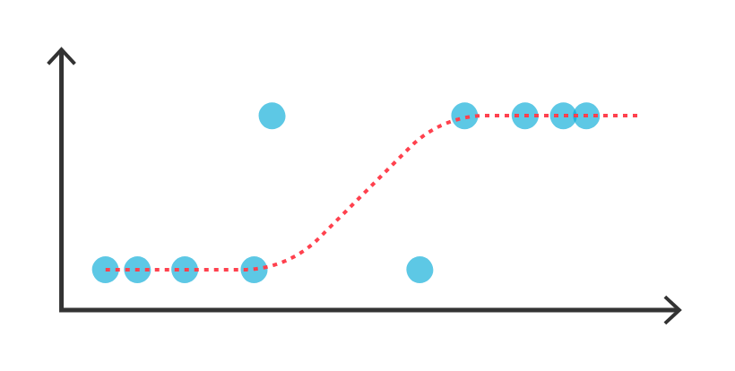
Limitations
Method specific – if you change your study you have to redo your power analysis
Only gives “best case” scenario for sample size
Notes:
Specifically with sample size, for example, let’s say you want to do a logistic regression. The power analysis might say you only need 30 sample points, but to actually do a logistic regression properly you need WAY more than that since logistic regression is based on maximum likelihood methods which need more data than 30 points.

Slide 27
Retrospective Power Analyses
Some people do their power analysis after they’ve tested their hypothesis.
Can be helpful for studies that did not reject their null hypothesis
If based on observed effect size, these are misleading
Need to be done with effect sizes hypothesized to biologically significant
Also need to report the alpha, effect sizes, and sample sizes used in calculations
Notes:
I would highly recommend you all doing a retrospective power analysis for your DS projects. They’re relatively easy, and they can actually be really helpful. There are a few caveats, and often people do them incorrectly, but if you do them properly it’s okay.

